Slide 1


Noida Institute of Engineering and Technology, Greater Noida
Concurrency in Java and I/O Stream
Unit : 4
OOTS with Java
Aditee Mattoo
Assistant Professor
CSE IoT
B.tech 3rd Sem

Slide 2
Content
Threads: Introduction and Types
Creating Threads
Thread Life-Cycle
Thread Priorities
Daemon Thread
Runnable Class
Synchronizing Threads
I/O Stream: Introduction and Types
Common I/O Stream Operations
Interaction with I/O Streams Classes
Annotations: Introduction
Custom Annotations
Applying Annotations

Slide 3
Course Objective
The objective of this course is to understand the object-oriented methodology and its techniques to design and develop conceptual models and demonstrate the standard concepts of object-oriented techniques modularity, I/O, and other standard language constructs.
The basic objective of this course is to understand the fundamental concepts of object-oriented programming in Java language and implement the Multithreading concepts, GUI based application and collection framework.

Slide 4
Course Outcome
SEMESTER | COURSE | S.NO | DESCRIPTION | Bloom’s Taxonomy Level
3rd Semester | Object Oriented Techniques with Java | CO1 | Identify the concepts of object-oriented programming and relationships among them needed in modeling. | K2
 |  | CO2 | Demonstrate the Java programs using OOP principles and implement the concepts of lambda expressions. | K3
 |  | CO3 | Implement packages with different protection level resolving namespace collision and evaluate the error handling concepts for uninterrupted execution of Java program. | K3, K5
 |  | CO4 | Implement Concurrency control, I/O Streams and Annotations concepts by using Java program. | K3
 |  | CO5 | Design and develop the GUI based application, Generics and Collections in Java programming language to solve the real-world problem | K6

Slide 5
CO-PO and PSO Mapping
CO-PO correlation matrix
CO-PSO correlation matrix
*H= High *M= Medium
Sr. No | Course Outcome | PO1 | PO2 | PO3 | PO4 | PO5 | PO6 | PO7 | PO8 | PO9 | PO10 | PO11 | PO12
1 | CO 1
2 | CO 2
3 | CO 3
4 | CO 4
5 | CO 5
Program Specific Outcomes | Course Outcomes
 | CO1 | CO2 | CO3 | CO4 | CO5
1
2
3
4

Slide 6
Objective of Unit
This course gives the fundamental knowledge of threads, I/O control and annotations.
The unit will help the students to understand how the approaches of threads help in solving real life problems.
Basic understanding of I/O operations used.
Overview of creating custom annotations and using them in programs.

Slide 7
Prerequisite and Recap
Student must know at least the basics of how to use a computer and should be able to start a command line shell.
Knowledge of basic programming concepts, as covered in ‘Programming Basic” course is necessary.

Slide 8
Threads in JAVA
A thread is actually a lightweight process. Unlike many other computer languages, Java provides built-in support for multithreaded programming.
Threads are sometimes called lightweight processes because they have their own stack but can access shared data. Because threads share the same address space as the process and other threads within the process, the operational cost of communication between the threads is low, which is an advantage. Also an operating system (OS) maintains smaller data structures for a thread than for a process.
A multithreaded program contains two or more parts that can run concurrently.
Each part of such a program is called thread and each thread defines a separate path of execution.
Thus, multithreading is a specialized form of multitasking.

Slide 9

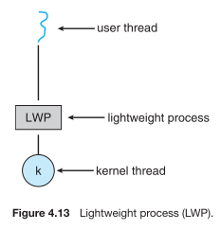

Slide 10
Threads: Introduction
Threads
Threads allows a program to operate more efficiently by doing multiple things at the same time.
Threads can be used to perform complicated tasks in the background without interrupting the main program.
Java is a multi-threaded programming language which means we can develop multi-threaded program using Java.
A multi-threaded program contains two or more parts that can run concurrently, and each part can handle a different task at the same time making optimal use of the available resources specially when your computer has multiple CPUs.
Multitasking is when multiple processes share common processing resources such as a CPU.

Slide 11
Threads: Introduction
Multi-threading extends the idea of multitasking into applications where you can subdivide specific operations within a single application into individual threads.
Each of the threads can run in parallel.
The OS divides processing time not only among different applications, but also among each thread within an application.
Multi-threading enables you to write in a way where multiple activities can proceed concurrently in the same program.
They utilize the minimum resources of the system. Thread takes less memory and less process time.

Slide 12
Types of Threads
Types of threads
There are two types of Threads in java.
User threads are threads which are created by the application or user.
They are high priority threads.
JVM (Java Virtual Machine) will not exit until all user threads finish their execution.
JVM wait for these threads to finish their task. These threads are foreground threads.

Slide 13
Types of Threads
Daemon or system defined threads are threads which are mostly created by the JVM.
These threads always run-in background.
These threads are used to perform some background tasks like garbage collection and house-keeping tasks.
These threads are less priority threads.
JVM will not wait for these threads to finish their execution.
JVM will exit as soon as all user threads finish their execution.
JVM doesn’t wait for daemon threads to finish their task.

Slide 14
Creating Threads
Create a Thread by Implementing a Runnable Interface
If your class is intended to be executed as a thread, then you can achieve this by implementing a Runnable interface. You will need to follow three basic steps −
Step 1
As a first step, you need to implement a run() method provided by a Runnable interface. This method provides an entry point for the thread, and you will put your complete business logic inside this method. Following is a simple syntax of the run() method −
public void run( )

Slide 15
Creating Threads
Step 2
As a second step, you will instantiate a Thread object using the following constructor −
Thread(Runnable threadObj, String threadName);
Where, threadObj is an instance of a class that implements the Runnable interface and threadName is the name given to the new thread.
Step 3
Once a Thread object is created, you can start it by calling start() method, which executes a call to run( ) method. Following is a simple syntax of start() method −
void start();

Slide 16
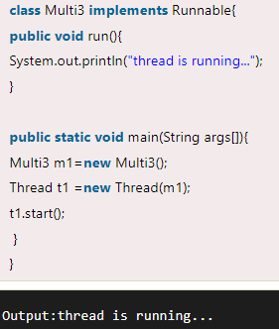
Creating Threads
Example:

Slide 17
Creating Threads
Create a Thread by Extending a Thread Class
The second way to create a thread is to create a new class that extends Thread class using the following two simple steps. This approach provides more flexibility in handling multiple threads created using available methods in Thread class.
Step 1
You will need to override run( ) method available in Thread class. This method provides an entry point for the thread, and you will put your complete business logic inside this method. Following is a simple syntax of run() method −
public void run( )

Slide 18
Creating Threads
Step 2
Once Thread object is created, you can start it by calling start() method, which executes a call to run( ) method. Following is a simple syntax of start() method-
void start( );

Slide 19
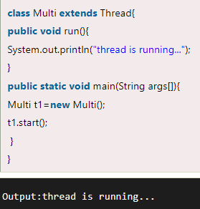
Creating Threads
Example:

Slide 20
Thread Lifecycle
A thread in Java at any point of time exists in any one of the following states. A thread lies only in one of the shown states at any instant:
New
Runnable
Blocked
Waiting
Timed Waiting
Terminated

Slide 21
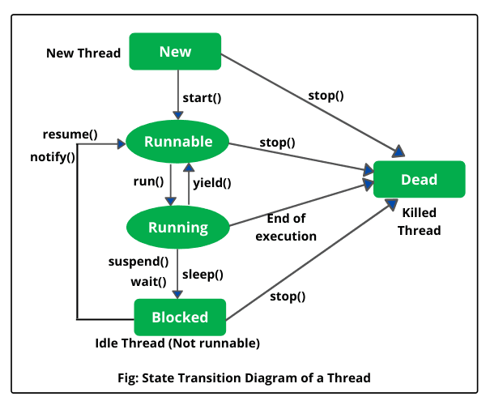
Thread Lifecycle
The diagram shown below represent various states of a thread at any instant of time. (https://www.scientecheasy.com/2020/08/life-cycle-of-thread-in-java.html/)

Slide 22
Thread Lifecycle
New Thread: When a new thread is created, it is in the new state.
The thread has not yet started to run when thread is in this state.
When a thread lies in the new state, it’s code is yet to be run and hasn’t started to execute.
Runnable State: A thread that is ready to run is moved to runnable state.
In this state, a thread might be running or it might be ready run at any instant of time. It is the responsibility of the thread scheduler to give the thread, time to run.
A multi-threaded program allocates a fixed amount of time to each individual thread.
Each thread runs for a short while and then pauses and relinquishes the CPU to another thread, so that other threads can get a chance to run.
When this happens, all such threads that are ready to run, waiting for the CPU and the currently running thread lies in runnable state.

Slide 23
Thread Lifecycle
Blocked/Waiting state: When a thread is temporarily inactive, then it’s in one of the following states:
Blocked
Waiting
For example, when a thread is waiting for I/O to complete, it lies in the blocked state.
It’s the responsibility of the thread scheduler to reactivate and schedule a blocked/waiting thread.
A thread in this state cannot continue its execution any further until it is moved to runnable state. Any thread in these states does not consume any CPU cycle.
A thread is in the blocked state when it tries to access a protected section of code that is currently locked by some other thread.

Slide 24
Thread Lifecycle
When the protected section is unlocked, the schedule picks one of the thread which is blocked for that section and moves it to the runnable state.
Whereas, a thread is in the waiting state when it waits for another thread on a condition.
When this condition is fulfilled, the scheduler is notified and the waiting thread is moved to runnable state.
If a currently running thread is moved to blocked/waiting state, another thread in the runnable state is scheduled by the thread scheduler to run.
It is the responsibility of thread scheduler to determine which thread to run.

Slide 25
Thread Lifecycle
Timed Waiting: A thread lies in timed waiting state when it calls a method with a time out parameter.
A thread lies in this state until the timeout is completed or until a notification is received.
For example, when a thread calls sleep or a conditional wait, it is moved to a timed waiting state.
Terminated State: A thread terminates because of either of the following reasons:
Because it exists normally. This happens when the code of thread has entirely executed by the program.
Because there occurred some unusual erroneous event, like segmentation fault or an unhandled exception.
A thread that lies in a terminated state does no longer consumes any cycles of CPU.

Slide 26
Thread Priorities
Every Java thread has a priority that helps the operating system determine the order in which threads are scheduled.
Java thread priorities are in the range between MIN_PRIORITY (a constant of 1) and MAX_PRIORITY (a constant of 10). By default, every thread is given priority NORM_PRIORITY (a constant of 5).
Threads with higher priority are more important to a program and should be allocated processor time before lower-priority threads.
However, thread priorities cannot guarantee the order in which threads execute and are very much platform dependent.

Slide 27
Daemon Thread
Daemon thread in java is a service provider thread that provides services to the user thread.
Its life depend on the mercy of user threads i.e. when all the user threads dies, JVM terminates this thread automatically.
There are many java daemon threads running automatically e.g. gc, finalizer etc.
Points to remember for Daemon Thread in Java
It provides services to user threads for background supporting tasks. It has no role in life than to serve user threads.
Its life depends on user threads.
It is a low priority thread.

Slide 28
Daemon Thread
Methods for Java Daemon thread by Thread class
The java.lang.Thread class provides two methods for java daemon thread.
No. | Method | Description
1) | public void setDaemon(boolean status) | is used to mark the current thread as daemon thread or user thread.
2) | public boolean isDaemon() | is used to check that current is daemon.

Slide 29
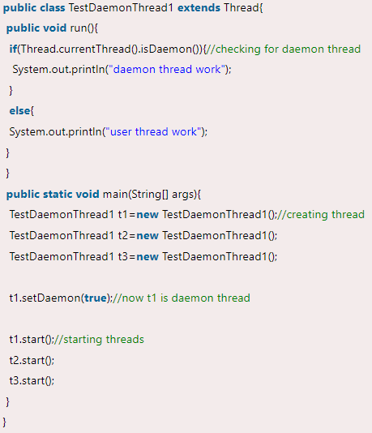
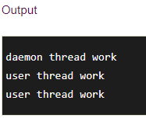
Daemon Thread Example

Slide 30
Runnable Class
java.lang.Runnable is an interface that is to be implemented by a class whose instances are intended to be executed by a thread.
There are two ways to start a new Thread – Subclass Thread and implement Runnable.
There is no need of subclassing Thread when a task can be done by overriding only run() method of Runnable.
Create a Runnable implementer and implement run() method.
Instantiate Thread class and pass the implementer to the Thread, Thread has a constructor which accepts Runnable instance.
Invoke start() of Thread instance, start internally calls run() of the implementer. Invoking start(), creates a new Thread which executes the code written in run().
Calling run() directly doesn’t create and start a new Thread, it will run in the same thread. To start a new line of execution, call start() on the thread.

Slide 31
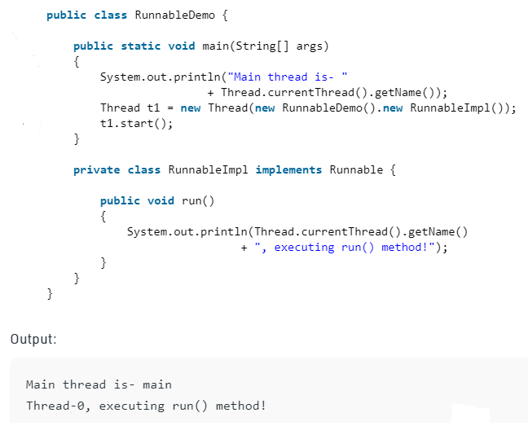
Runnable Class Example

Slide 32
Synchronized Threads
The process of allowing multiple threads to modify an object in a sequence is called synchronization.
We can allow multiple threads to modify the objects sequentially only by executing that objects’ mutator methods logic in sequence from multiple threads.
This is possible by using an object locking concept.
Thread Synchronization is a process of allowing only one thread to use the object when multiple threads are trying to use the object at the same time.
To achieve this Thread Synchronization, we must use a java keyword or modifier called “synchronized”.
Synchronization in java is the capability to control the access of multiple threads to any shared resource. Java Synchronization is a better option where we want to allow only one thread to access the shared resource.

Slide 33
Synchronized Threads
General Syntax: synchronized(objectidentifier) { // Access shared variables and other shared resources; }
Why use Synchronization?
The synchronization is mainly used to :
If you start with at least two threads inside a program, there might be a chance when multiple threads attempt to get to the same resource.
It can even create an unexpected outcome because of concurrency issues.

Slide 34
Synchronized Threads
Types of Synchronization
There are basically two types of synchronization available. They are:
Process Synchronization: It means sharing system resources by processes in such a way that, Concurrent access to shared data is handled thereby minimizing the chance of inconsistent data.
Thread Synchronization: It means that every access to data shared between threads is protected so that when any thread starts operation on the shared data, no other thread is allowed access until the first thread is done.

Slide 35
Synchronized Threads
Locks in Java
Synchronization is built around an internal entity known as the lock or monitor lock. (The API specification often refers to this entity simply as a “monitor.”)
Locks play a role in both aspects of synchronization: enforcing exclusive access to an object’s state and establishing happens-before relationships that are essential to visibility.
Every object has a lock associated with it.
By convention, a thread that needs exclusive and consistent access to an object’s fields has to acquire the object’s lock before accessing them, and then release the lock when it’s done with them.
A thread is said to own the lock between the time it has acquired the lock and released the lock.
As long as a thread owns a lock, no other thread can acquire the same lock. The other thread will block when it attempts to acquire the lock.

Slide 36

I/O Stream: Introduction
Java brings various Streams with its I/O package that helps the user to perform all the input-output operations.
These streams support all the types of objects, data-types, characters, files etc to fully execute the I/O operations.

Slide 37
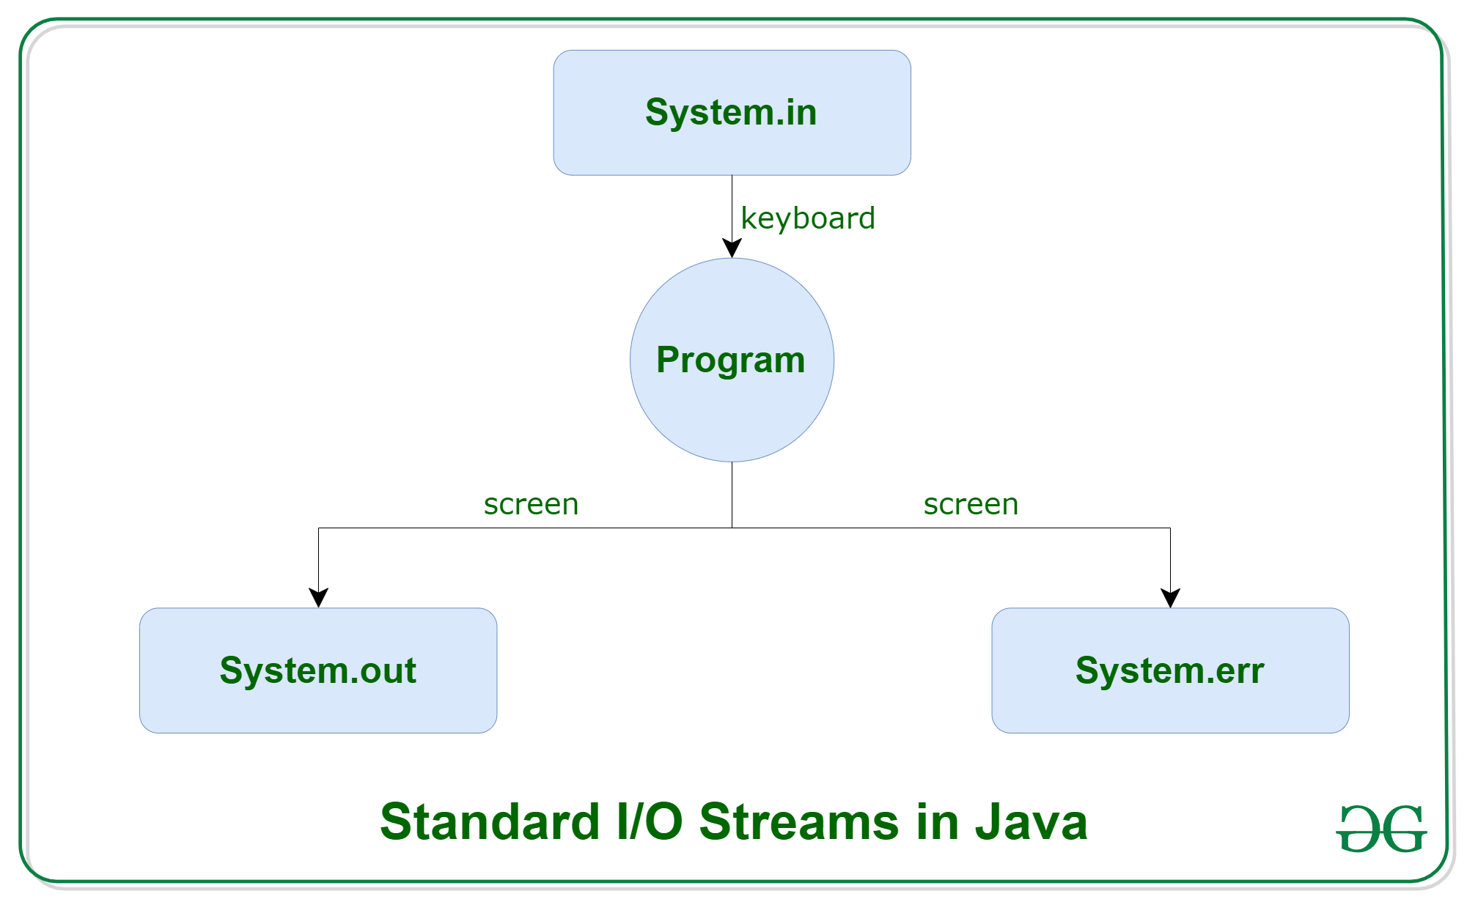
I/O Stream: Introduction
Before exploring various input and output streams lets look at 3 standard or default streams that Java must provide which are also most common in use:

Slide 38
I/O Stream: Introduction
System.in: This is the standard input stream that is used to read characters from the keyboard or any other standard input device.
System.out: This is the standard output stream that is used to produce the result of a program on an output device like the computer screen.
Here is a list of the various print functions that we use to output statements:
print(): This method in Java is used to display a text on the console.
This text is passed as the parameter to this method in the form of String.
This method prints the text on the console and the cursor remains at the end of the text at the console.
The next printing takes place from just here.
Syntax:
System.out.print(parameter);

Slide 39
I/O Stream: Introduction
println(): This method in Java is also used to display a text on the console.
It prints the text on the console and the cursor moves to the start of the next line at the console.
The next printing takes place from the next line.
Syntax:
System.out.println(parameter);
printf(): This is the easiest of all methods as this is similar to printf in C.
Note that System.out.print() and System.out.println() take a single argument, but printf() may take multiple arguments.
This is used to format the output in Java.

Slide 40
I/O Stream: Introduction
System.err: This is the standard error stream that is used to output all the error data that a program might throw, on a computer screen or any standard output device.
This stream also uses all the 3 above-mentioned functions to output the error data:
print()
println()
printf()

Slide 41
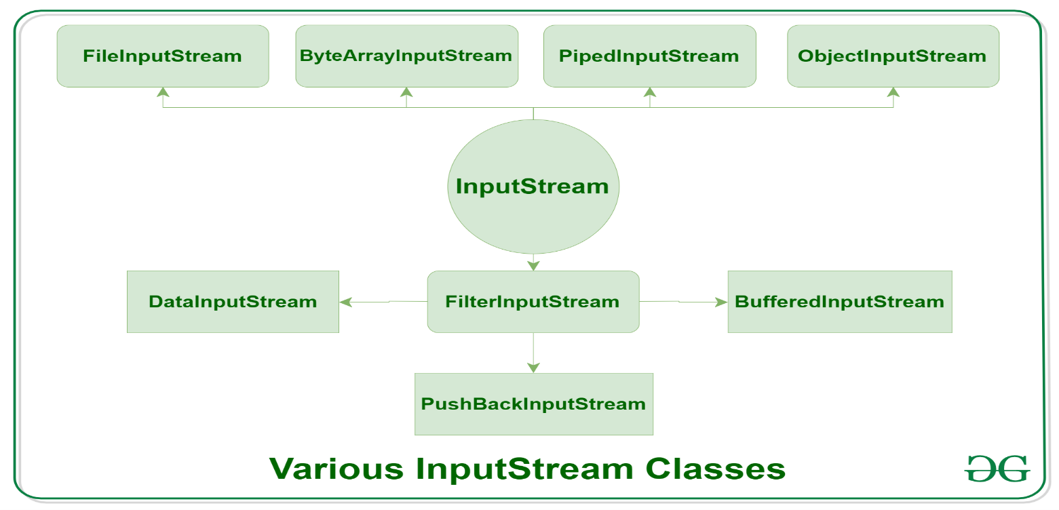
Types of Streams
Depending on the type of operations, streams can be divided into two primary classes:
Input Stream: These streams are used to read data that must be taken as an input from a source array or file or any peripheral device. For eg., FileInputStream, BufferedInputStream, ByteArrayInputStream etc.

Slide 42
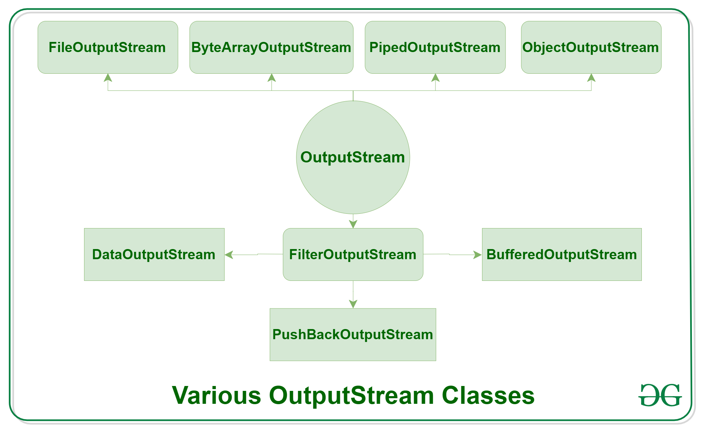
Types of Streams
Output Stream: These streams are used to write data as outputs into an array or file or any output peripheral device. For eg., FileOutputStream, BufferedOutputStream, ByteArrayOutputStream etc.

Slide 43
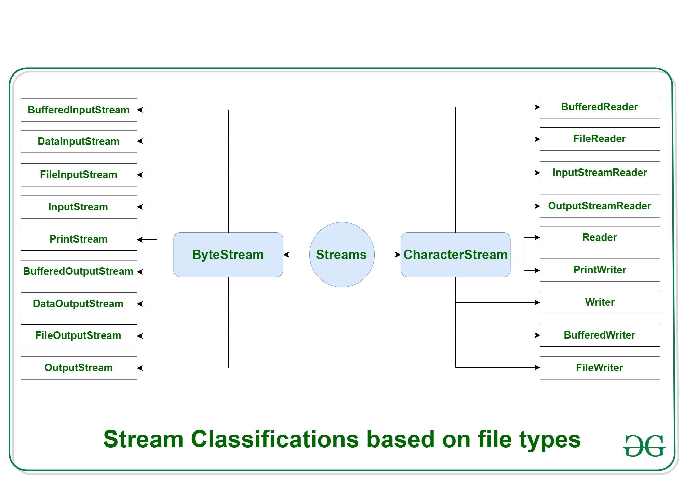
Types of Streams
Depending on the types of file, Streams can be divided into two primary classes which can be further divided into other classes as can be seen through the diagram below followed by the explanations.

Slide 44
Types of Streams
ByteStream: This is used to process data byte by byte (8 bits).
Though it has many classes, the FileInputStream and the FileOutputStream are the most popular ones.
The FileInputStream is used to read from the source and FileOutputStream is used to write to the destination.
CharacterStream: In Java, characters are stored using Unicode conventions.
Character stream automatically allows us to read/write data character by character.
Though it has many classes, the FileReader and the FileWriter are the most popular ones.
FileReader and FileWriter are character streams used to read from the source and write to the destination respectively.

Slide 45
Common I/O Stream Operations
Useful methods of Output Stream
Method | Description
1) public void write(int)throws IOException | is used to write a byte to the current output stream.
2) public void write(byte[])throws IOException | is used to write an array of byte to the current output stream.
3) public void flush()throws IOException | flushes the current output stream.
4) public void close()throws IOException | is used to close the current output stream.

Slide 46
Common I/O Stream Operations
Useful methods of Input Stream
Method | Description
1) public abstract int read()throws IOException | reads the next byte of data from the input stream. It returns -1 at the end of the file.
2) public int available()throws IOException | returns an estimate of the number of bytes that can be read from the current input stream.
3) public void close()throws IOException | is used to close the current input stream.

Slide 47
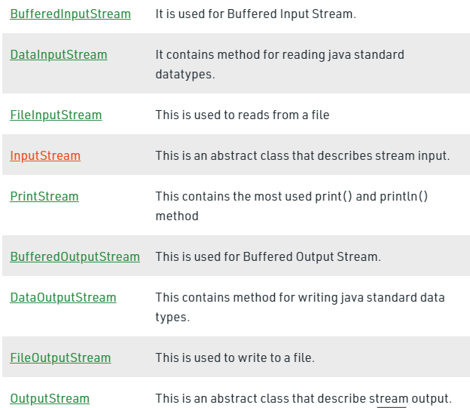
Interaction with I/O Streams Classes

Slide 48
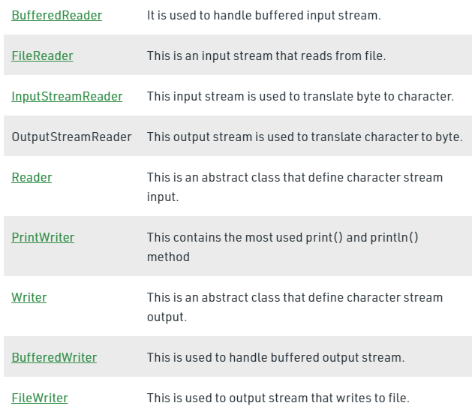
Interaction with I/O Streams Classes

Slide 49
Annotations: Introduction
Annotations are used to provide supplement information about a program.
Annotations start with ‘@’.
Annotations do not change action of a compiled program.
Annotations help to associate metadata (information) to the program elements i.e. instance variables, constructors, methods, classes, etc.
Annotations are not pure comments as they can change the way a program is treated by compiler.

Slide 50
Annotations: Introduction
Built-In Java Annotations used in Java code
@Override
@SuppressWarnings
@Deprecated
@Override
@Override annotation assures that the subclass method is overriding the parent class method. If it is not so, compile time error occurs.
@SuppressWarnings
@SuppressWarnings annotation is used to suppress warnings issued by the compiler.
@Deprecated
@Deprecated annotation marks that this method is deprecated so compiler prints warning. It informs user that it may be removed in the future versions. So, it is better not to use such methods.

Slide 51
Custom Annotations
Java Custom annotations or Java User-defined annotations are easy to create and use. The @interface element is used to declare an annotation. For example:
@interface MyAnnotation{}
Here, MyAnnotation is the custom annotation name.
Points to remember for java custom annotation signature
Method should not have any throws clauses
Method should return one of the following: primitive data types, String, Class, enum or array of these data types.
Method should not have any parameter.
We should attach @ just before interface keyword to define annotation.
It may assign a default value to the method.

Slide 52
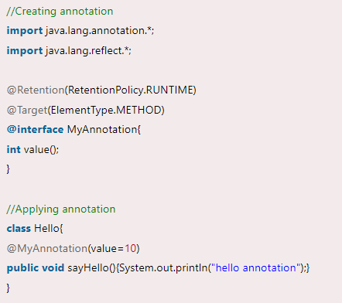
Applying Annotations
Example of custom annotation: creating, applying and accessing annotation

Slide 53
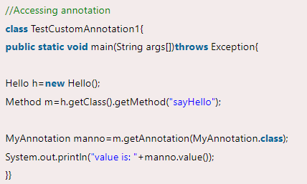

Applying Annotations

Slide 54
Thank You

